Slide 1





Digitization and Data Management System for RPL of Safai Karamcharis
6th September, 2018
www.smaltandberyl.com

Slide 2

Present problem in the system
Notes:
Time and cost
Manual and redundant effort
Operation overheads
Payment delays due to non-compliance of documents

Slide 3

Time and cost

Slide 4

Manual and
redundant effort

Slide 5

Operation overheads

Slide 6

Payment delays due to
non-compliance of documents
₹
₹
₹

Slide 7
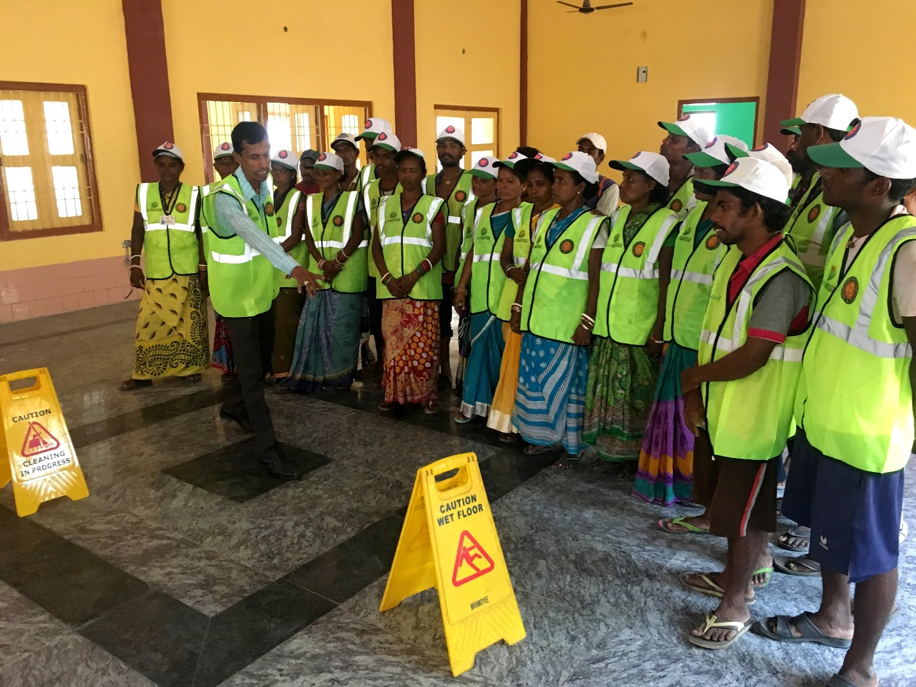

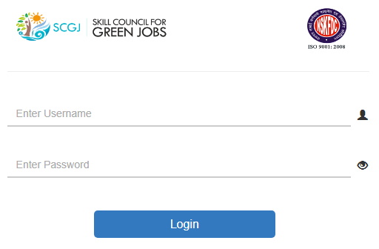
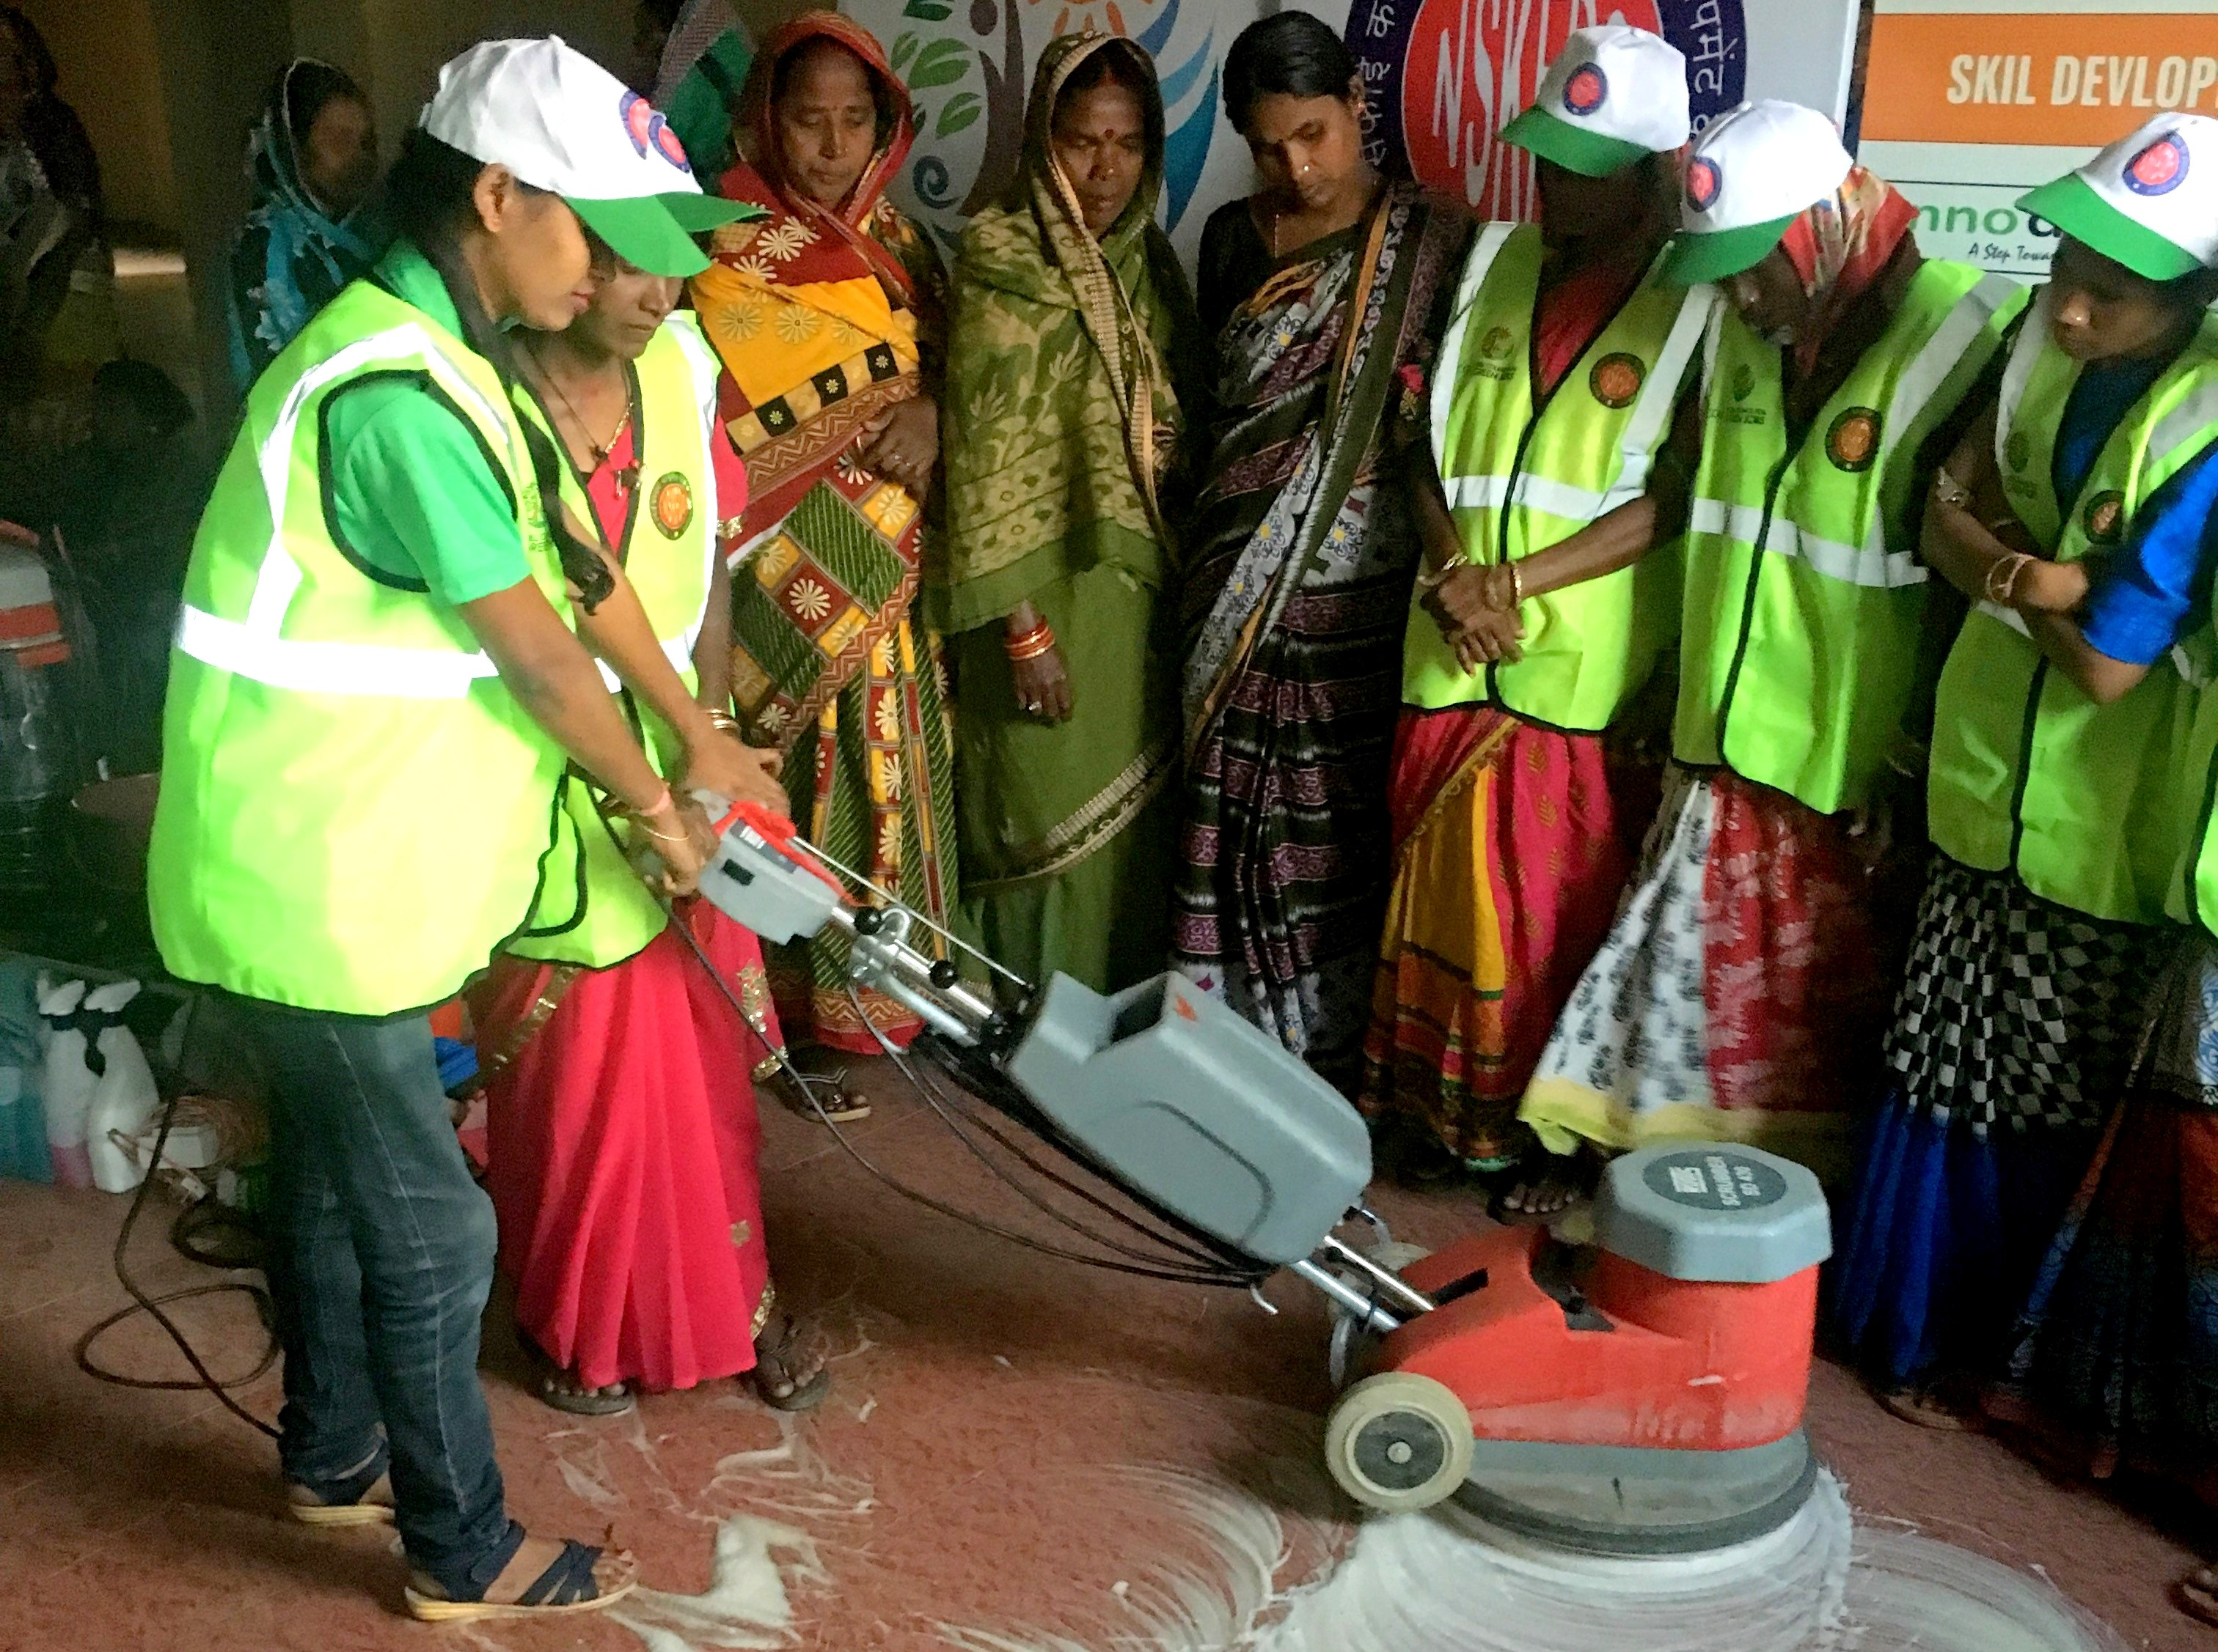

Technology enabled Solution

Slide 8
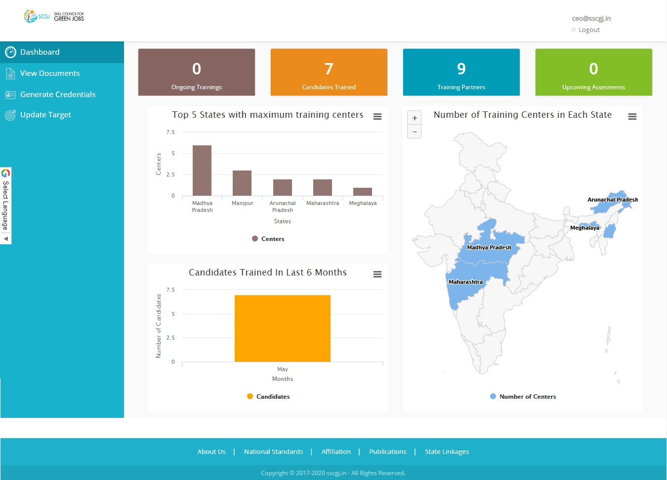
01
Dashboard and Infographics

Slide 9
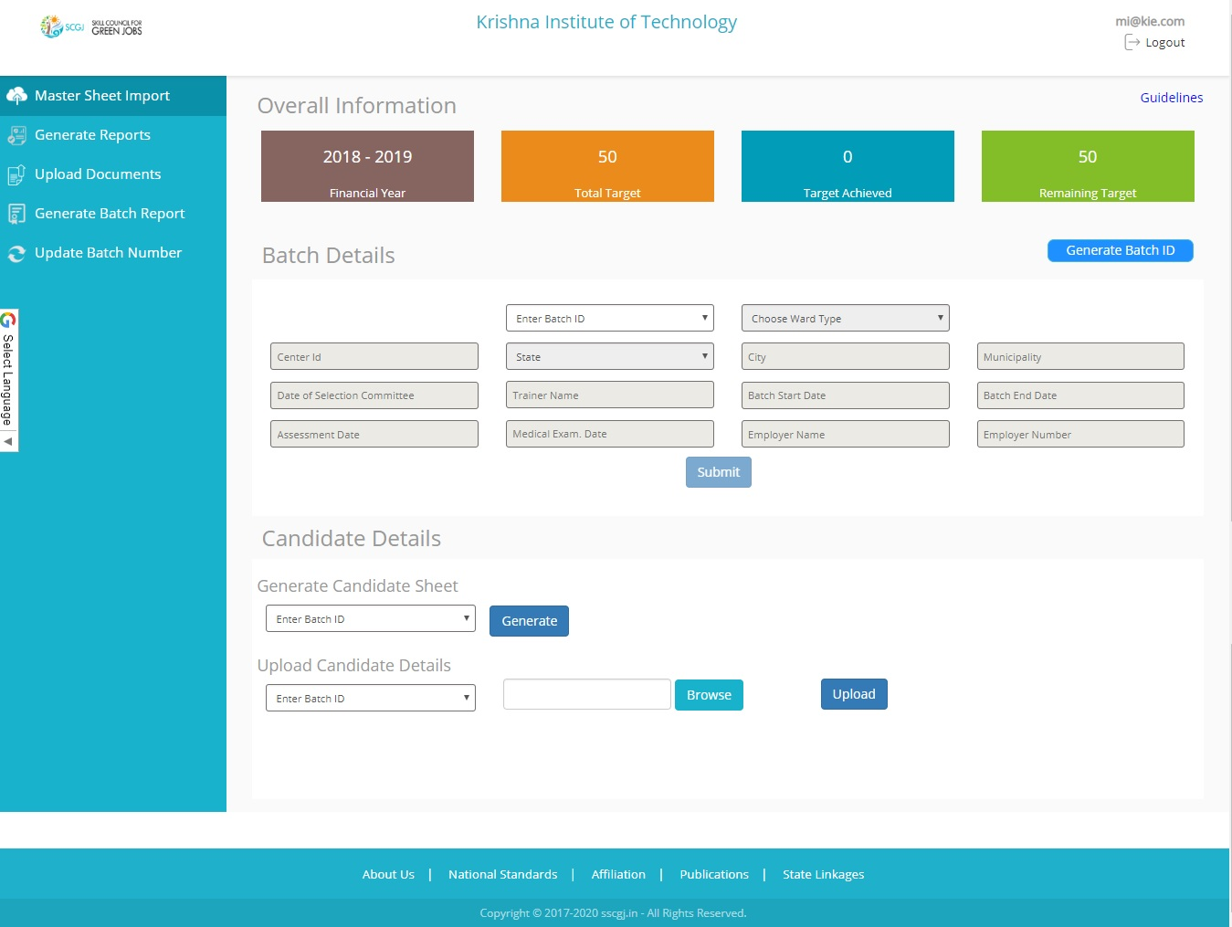
02
One time seamless data import

Slide 10
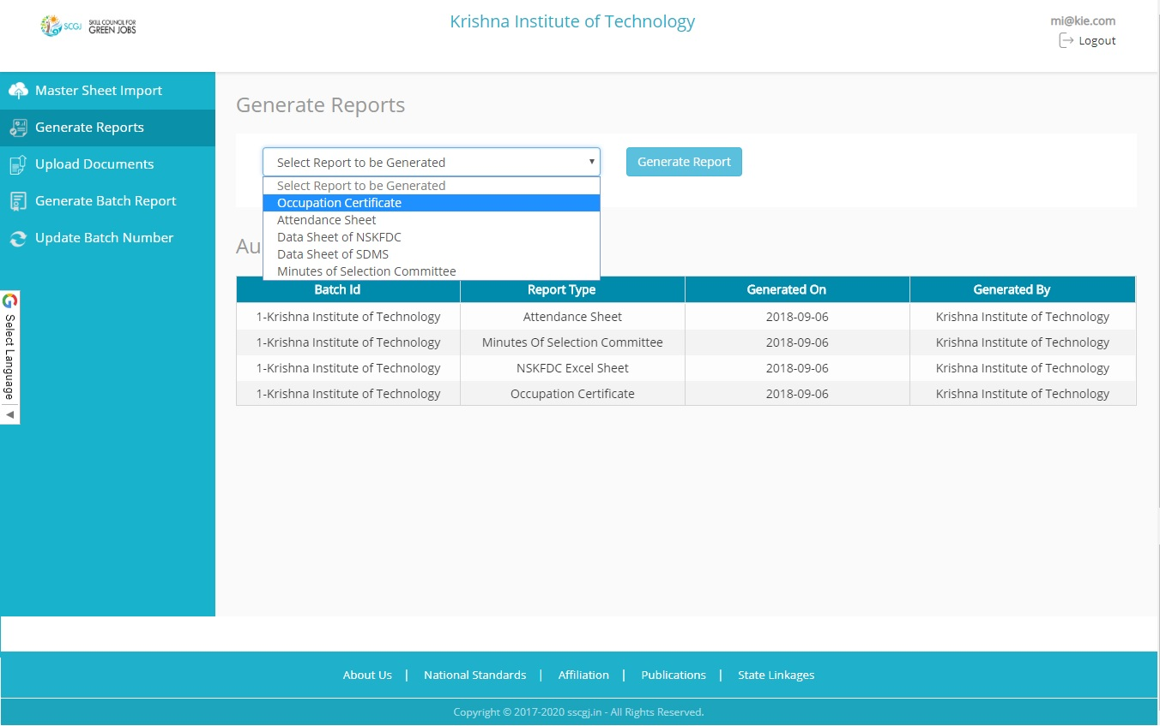
03
Automatic report generation

Slide 11
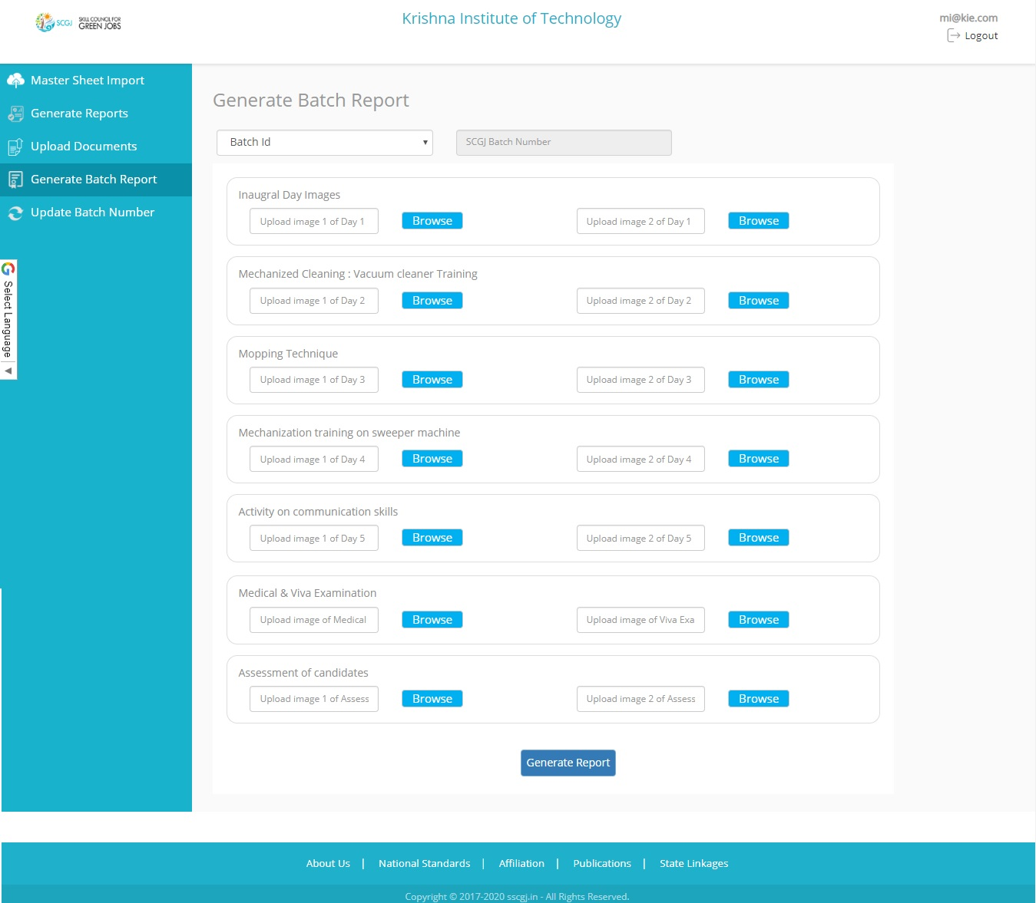
04
One click generation standardized final batch report

Slide 12
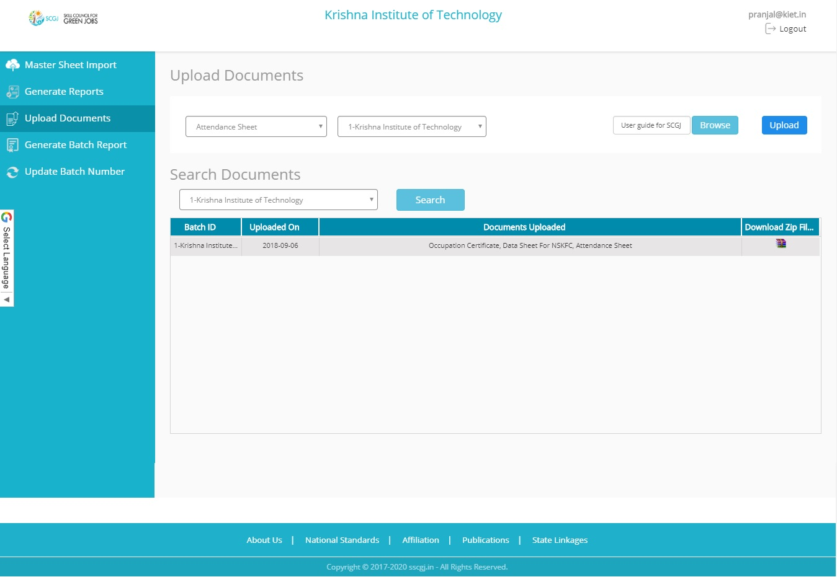
05
Quick and effective means to share documents

